Slide 1
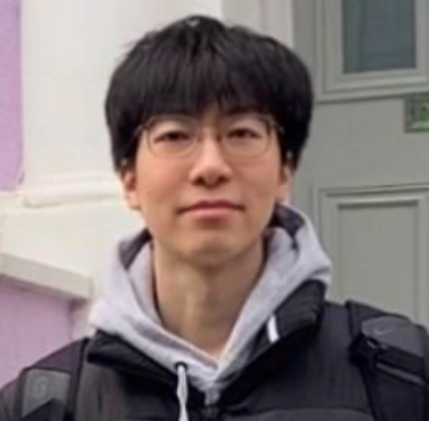

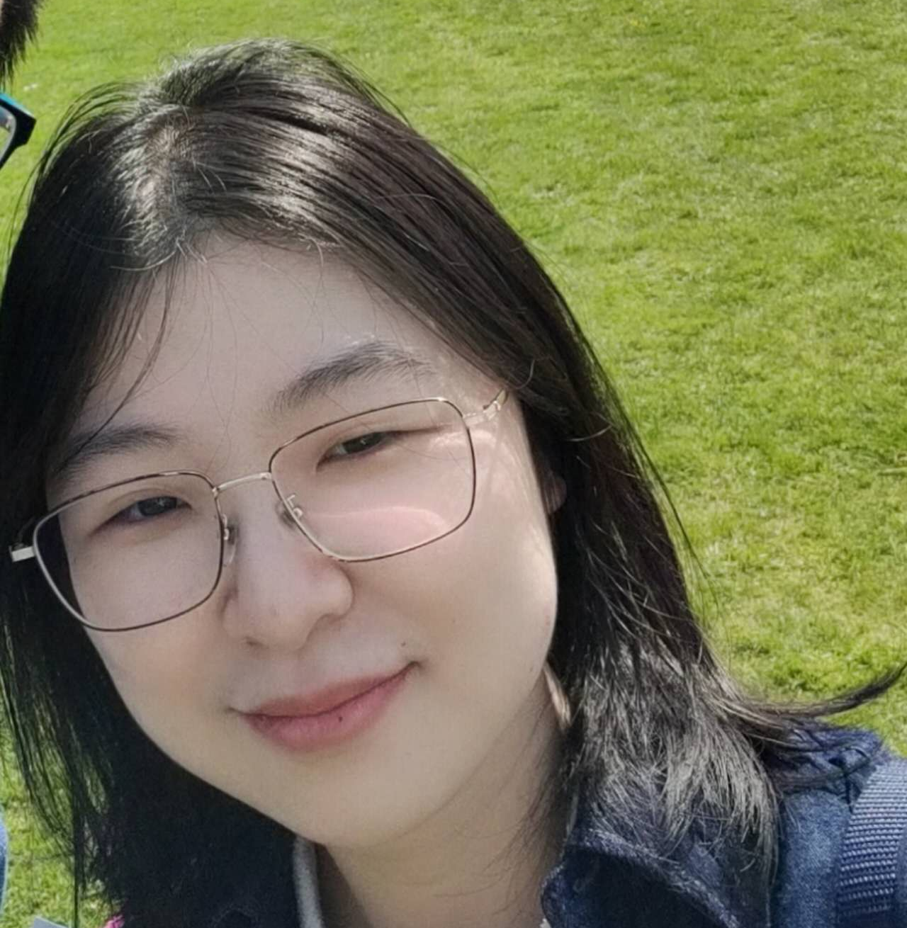

Towards Automated Polyp Segmentation Using Weakly- and Semi-Supervised Learning and Deformable Transformers
Guangyu Ren*, Michalis Lazarou*, Jing Yuan*, Tania Stathaki
Department of Electrical and Electronic Engineering, Imperial College London, London, SW7 2AZ, United Kingdom
* Equal contribution
Notes:
Hello everyone, My name is Michalis Lazarou and I will be presenting our work named “Towards Automated Polyp Segmentation Using Weakly- and Semi-Supervised Learning and Deformable Transformers”. First of all i would like to thank the workshop organizers for giving us the opportunity to present our work. This was a collaborative work between researchers from Imperial college London. My fellow co-authors are Guangyu Ren, Jing Yuan and Tania Stathaki.

Slide 2
Motivation
Polyp segmentation is crucial for diagnosis of colorectal cancer
Annotated datasets are tedious and time-consuming to produce
Save physicians' valuable time
Contributions
Provide the first weakly-annotated polyp dataset, W-Polyp
Weakly- and semi-supervised training framework, WS-DefSegNet
Propose a novel weakly-supervised loss function, Sparse foreground loss
Propose a novel progressive multi-scale architecture with a self-attention mechanism, DTEN
Notes:
Polyp segmentation is a crucial step for computer-aided diagnosis of colorectal cancer, which is one of the most common types of cancer in the world. Most of the polyp segmentation models must be trained on pixelwise annotated datasets that are tedious and time-consuming to produce. Furthermore, annotating images for polyp segmentation must be done from specialist physicians who would in turn need to sacrifice their time dedicated to their patients for annotating images .
To this end we are presenting our research that addresses the aforementioned problems. In this work we are investigating the problem of automated polyp segmentation using limited supervision. To this end we propose a framework For training a polyp segmentation model using Only weakly-annotated images and unlabeled images.
In our work We make the following contributions:
We provide the first publicly available weakly-annotated polyp dataset, W-Polyp, the link can be found in our paper
We present the first Weakly- and semi-supervised polyp segmentation framework, Named WS-DefSegNet,
We Propose a novel weakly-supervised loss function, Sparse foreground loss that alleviates the false positives associated with weakly supervised training
Lastly, We Propose a novel progressive multi-scale architecture with a self-attention mechanism for feature enhancement that significantly improves the performance of WS-DefSegNet.

Slide 3
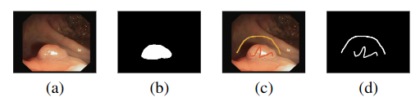
W-Polyp Dataset
1450 images in total
750 images weakly annotated with simple sketches, lines, scribbles and circles
700 images left unlabeled
a) RGB image, b) original ground truth, c) Foreground and background annotations, d) our weak annotations
Notes:
Regarding our weakly-annotated dataset: W-Polyp is created by weakly-annotating an existing polyp dataset, which contains 1,450 images in total. We randomly selected and annotated 750 images with simple sketches, including lines, scribbles and circles. Additionally, unlike other weakly-annotated dataset, the rest 700 images are left unlabeled maximizing the labeling efficiency and dataset sparsity. Further details can be found in our paper.

Slide 4
Overview of WS-DefSegNet
Weakly-supervised training
Semi-supervised training
Architecture design
Notes:
We will discuss our framework in three parts, firstly we will discuss the weakly-supervised training phase, then the semi-supervised training phase and then the architectural design of our framework.

Slide 5
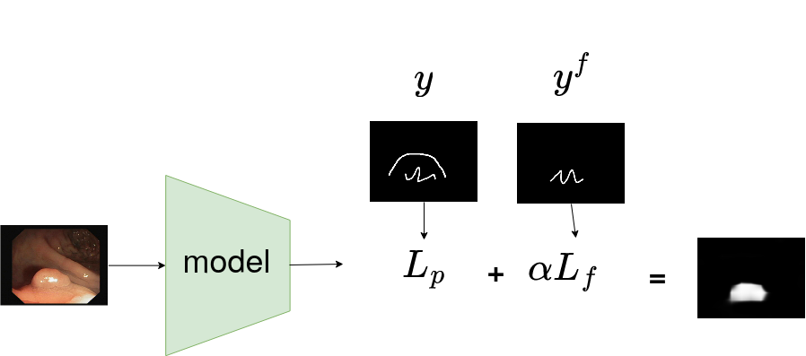
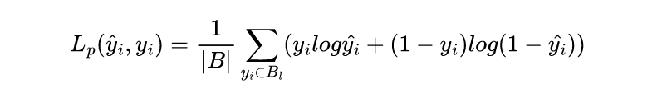
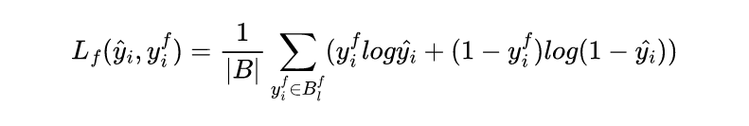
Weakly-supervised Training
Notes:
In the weakly-supervised training phase we train our model using only the weakly-annotated data. We use a weighted average of two losses, L_p which denotes the partial cross entropy loss and L_f which denotes the sparse foreground loss. It can be seen from the figure that the partial loss uses both foreground and background information while the sparse foreground loss uses only foreground information.

Slide 6
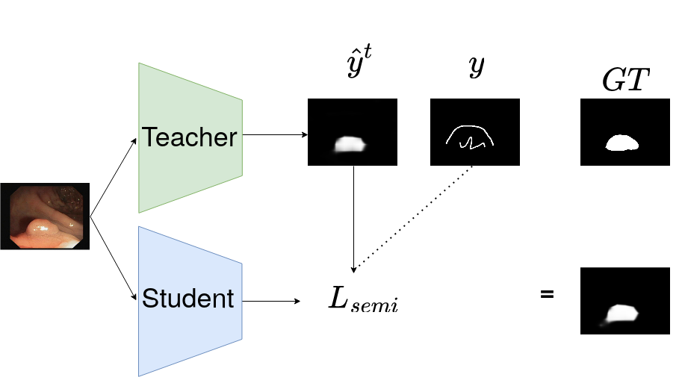

Semi-Supervised Training
Notes:
In the semi-supervised training phase, we adopt a teacher-student training paradigm and use the model trained from the weakly-supervised training phase to act as the teacher. The teacher model assigns pseudo-labels for all unlabeled images of the dataset and we train the student model using a consistency loss between the predicted pseudo-labels and the student's predictions. The loss function used to train the student model is the weighted sum of two terms, the loss function used in the weakly-supervised training and a consistency loss between the teacher's pseudo-labels and the student's predictions.

Slide 7
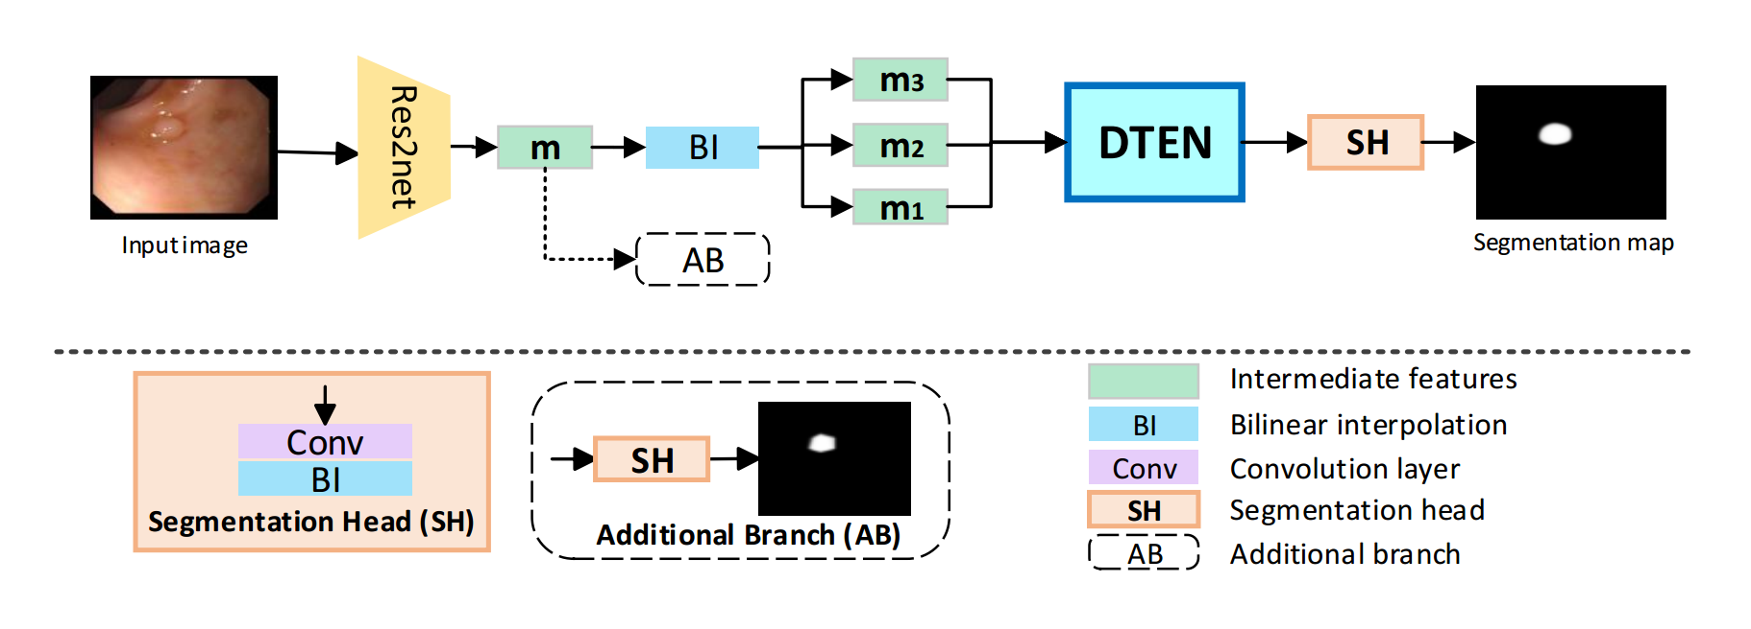
Architecture Design
The network architecture of our WS-DefSegNet.
Notes:
Moving on to the architecture design. Our network uses Res2Net as a backbone and utilizes the proposed Deformable Transformer Encoder Neck (DTEN) to enhance raw features produced by the backbone.
The Enhanced features are passed to a vanilla segmentation head. The additional branch in the dashed box only exists in the training stage.

Slide 8
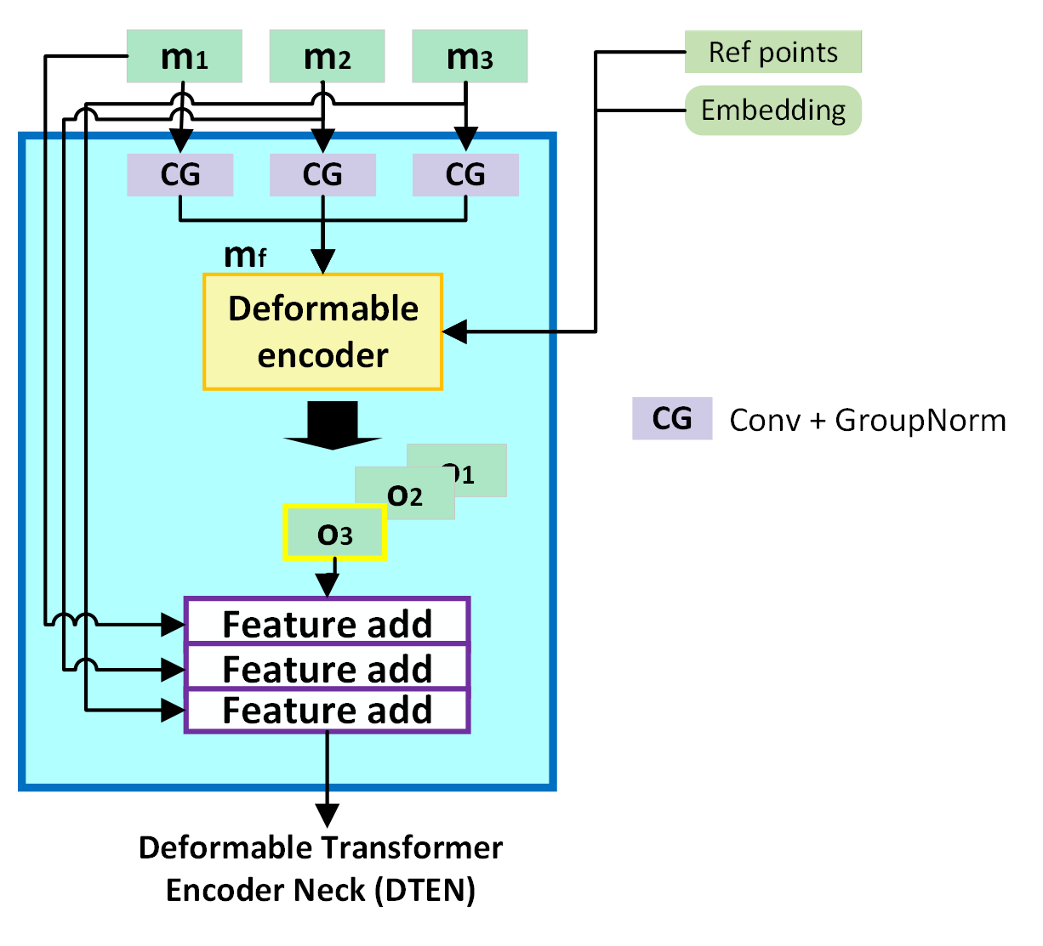
Deformable Transformer Encoder Neck
Adaptive feature fusion across multiple levels at learned locations with learned weight.
Notes:
We propose the DTEN module based on a single encoder of the deformable vision transformer and three feature add blocks.The overall structure of DTEN is shown on the left. The reason we use the deformable transformer is that its attention mechanism is suitable for adaptive feature extraction. Our module fuses features adaptively across multiple levels at learned locations so that the classification of each pixel considers the surrounding features with learned weight. Therefore, the attention to features inside the polyp can help the classification of pixels at ambiguous locations such as edges.

Slide 9
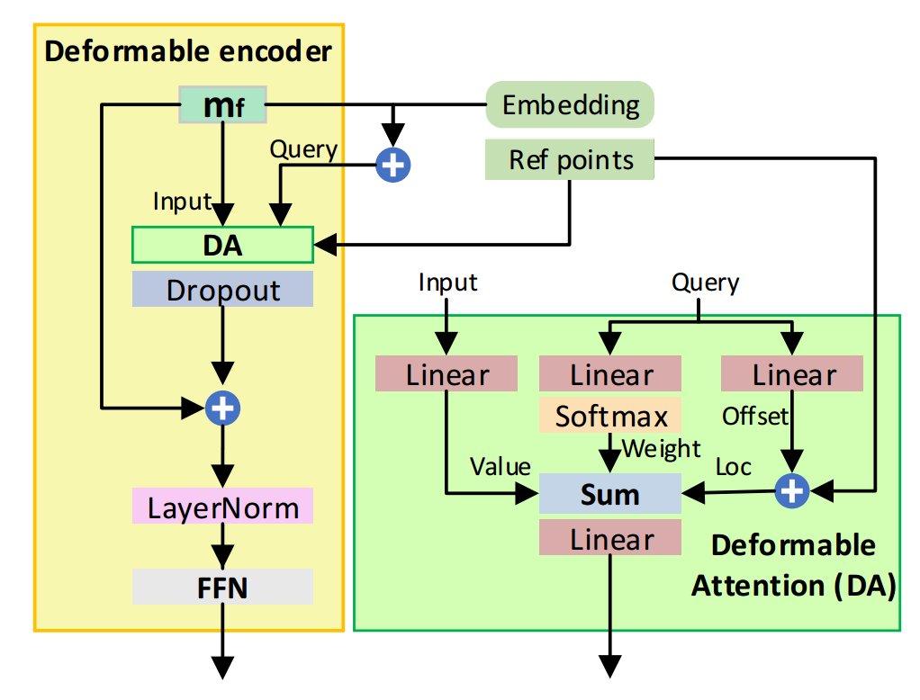
Deformable Encoder
The structure of a single encoder in deformable vision transformers*. The encoder enables the aggregation of useful features at learned locations with learnt significance across levels.
* Xizhou Zhu, Weijie Su, Lewei Lu, Bin Li, Xiaogang Wang, and Jifeng Dai. Deformable detr: Deformable transformers for end-to-end object detection. ArXiv, abs/2010.04159, 2021.
Notes:
Here we draw the detailed structure of the encoder of the deformable vision transformer in the yellow box in the middle. It mainly contains a deformable attention block and a typical Feed Forword Network. We show the details of the former in the green box. This deformable vision transformer is first proposed in 2021. It introduced the idea of deformability into traditional vision transformers like DETR in order to reduce the memory cost. Our model takes advantage of this deformable encoder so that the we can afford the training and achieve improvements at the same time.

Slide 10
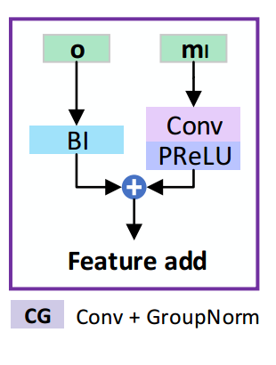
Feature Add (FA) Block in DTEN
Feature add modules progressively compensate the input feature map with enhanced features to produce a more expressive feature map.
Notes:
Besides the deformable vision transformer, another highlight of DTEN is the Feature Add block.
This block is designed to Compensate the input feature map with enhanced features.
As you can find on the left, we stack three blocks after the deformable encoder and they serve as the last steps of the DTEN module.
The detailed structure of a single Feature Add block is shown in the middle.
The original feature map is embedded via a convolution layer and the PReLU.
The enhanced map is upsampled to the same resolution as the original feature map via Bilinear Interpolation (BI).
Finally the results of these two branches are added element-wisely to form the compensated feature map.
With multiple blocks, the input features are complemented progressively to output a more expressive feature map.

Slide 11
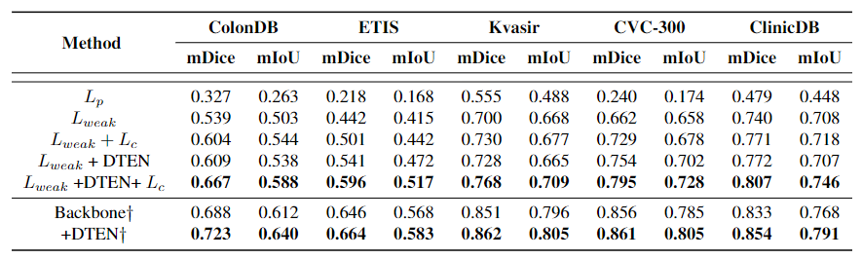
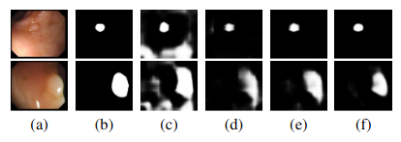
Ablation
(a) RGB image. (b) Original ground truth (c) backbone. (d) +sparse foreground loss. (e) +semi with weighted consistency loss. (f) +DTEN.
Notes:
We conduct experiments on five widely used polyp datasets, namely CVC-ColonDB, ETIS, Kvasir, CVC-T and CVC-ClinicDB. We follow previous works and use two metrics to calculate the performance of our polyp segmentation method, namely mean Dice (mDice) and mean IoU (mIoU). Here we ablate every component of our work. We start by having the baseline of using only the partial cross-entropy loss in the first row. Performance improvements can be seen when sparse foreground loss is used in row 2, the semi-supervised learning is utilized in row 3 and the use of DTEN in rows 4 and 5. Furthermore DTEN can also improve the performance when trained in a fully supervised way as it is shown in the last two rows.
Finally, from the visualizations of the segmentations maps the merits of our method can be clearly seen. The improvement from training only with the partial loss in column c) to the complete version of our framework in column f) is very significant.

Slide 12
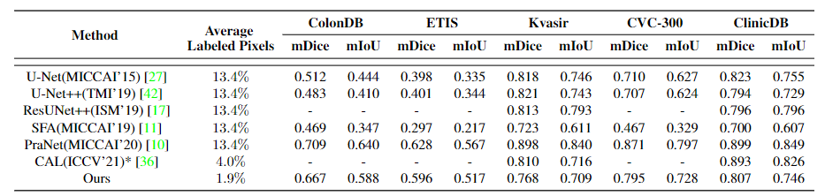
Comparison with State of the Art
Notes:
Lastly we compare our method with the state of the art in polyp detection. It can be seen that our method outperforms most of the state of the art polyp segmentation methods and is only slightly inferior when compared to two of them. However our method uses around 7x less annotated pixels than the supervised methods and around 2.5x less annotated pixels than the semi-supervised methods which makes our method a lot more efficient.

Slide 13
Thank you!
https://github.com/ic-qialanqian
https://github.com/MichalisLazarou
https://github.com/dogdogpee
http://www.commsp.ee.ic.ac.uk/~tania/
Notes:
Thank you for listening to our presentation, we hope you enjoyed it. In case you have any questions or are interested in this research direction please do not hesitate to contact us.

